Slide 1
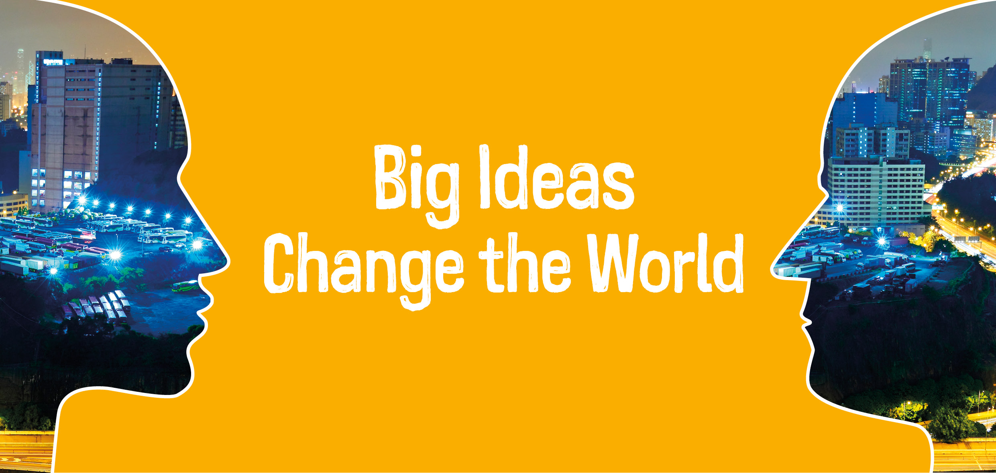

“A remarkable set of contemplations…”

Slide 2
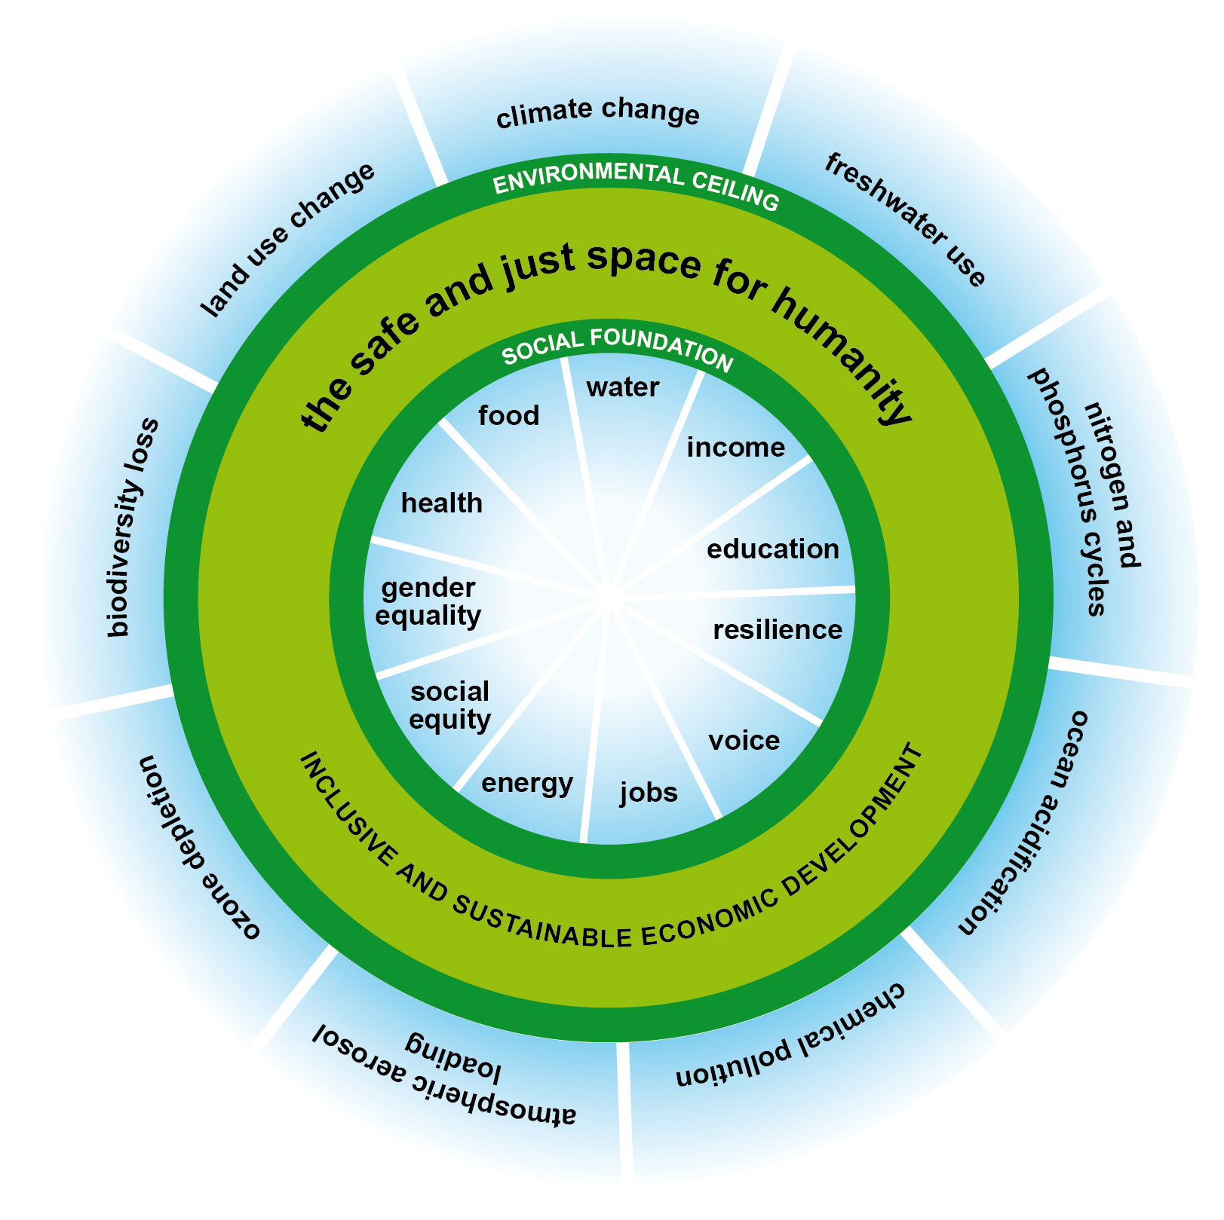
Where we want to get to:

Slide 3
10 big questions:
What changes are necessary to prevent over-harvesting of the planet’s bioproductivity?
How can we provide resilient, affordable, low-carbon energy for all?
How do politics and governance need to change to address global commons issues such as climate change?
Could women’s empowerment transform the chances of achieving sustainability?
How can we apply lessons from the past to the challenges of today?

Slide 4
10 big questions:
How can we focus economies and mainstream businesses on long-term sustainability?
What is a better foundation for people’s identity than consumption?
How can we foster innovation in technology and thinking to focus it on well-being without risking the environment?
How can we get money flowing to socially useful activities?
How can we get cities driving positive social, environmental and economic change?

Slide 5
Trends:
Shifting power, declining trust, clamour for political freedom
Bigger more integrated economies, greater instability
Environments stressed to breaking points
A larger, older, more urbanised population
Slowly declining discrimination, increasing economic inequality
Accelerated development of technology

Slide 6
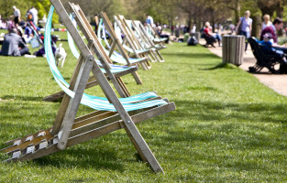
The importance of “sharing”
From green spaces, to cars, to energy to ideas
Resource efficiency
Community building
Social justice
Kick-back against individualistic capitalism

Slide 7
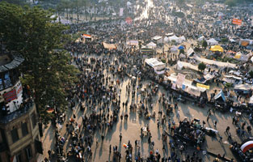
Greater self determination
More local control
Power distributed
Innovation
Decentralised power
Decentralised resilience

Slide 8
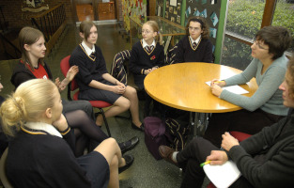
Deeper democracy
Better processes
Education for critical thinking
Lifelong education
Making space for public debate & protest

Slide 9
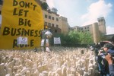
Empowering - disempowered
Rights to information, participation and justice. An internet commons
Controls on corporate lobbying / power / oligopolies
Women’s empowerment
Move to ‘purpose-driven businesses’

Slide 10

Empathy
Putting yourself in others shoes
Careful consumption
Start in school
Lifelong
Changes norms
Kick-back against individualism

Slide 11
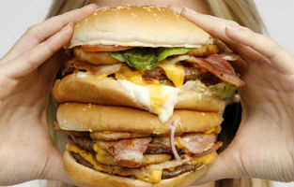
Sustainable consumption
Demand management of resources
Better physical and mental health costs
Focus on ‘wellbeing’
Lower NHS costs

Slide 12
Topics not yet completed
Women’s empowerment book published late 2015
History Conference – June 2015
Innovation – just started
Energy – starting spring 2015
Money – starting summer 2015

